Slide 1
TOGETHER, we win !
Campus mobility – Laboratories – Welfare and inclusion
Ioana-Maria Crasan, Universitatea din București
Ghada Hossam, La Universidad Autónoma de Madrid
Auri Kostama-Goerger, Aix-Marseille Université
Julian-Patrick Lotz, Eberhard Karls Universität Tübingen
Sara Massa, Sapienza Università di Roma

Slide 2
How to ensure EQUAL OPPORTUNITIES for
all university members?
« UNIVERSITY »
UNI… means unifies
VERSITY… means collection of differences in one place
A unity of differences and diversities but also of different abilities.
Photo © Shutterstock

Slide 3
Focus on Disability > Physical disabilities
Campus mobility
Laboratories
Welfare and inclusion
Photo © Shutterstock

Slide 4
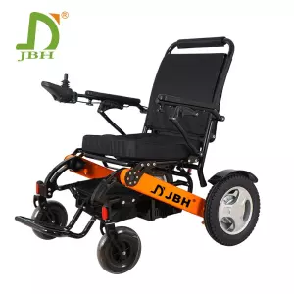
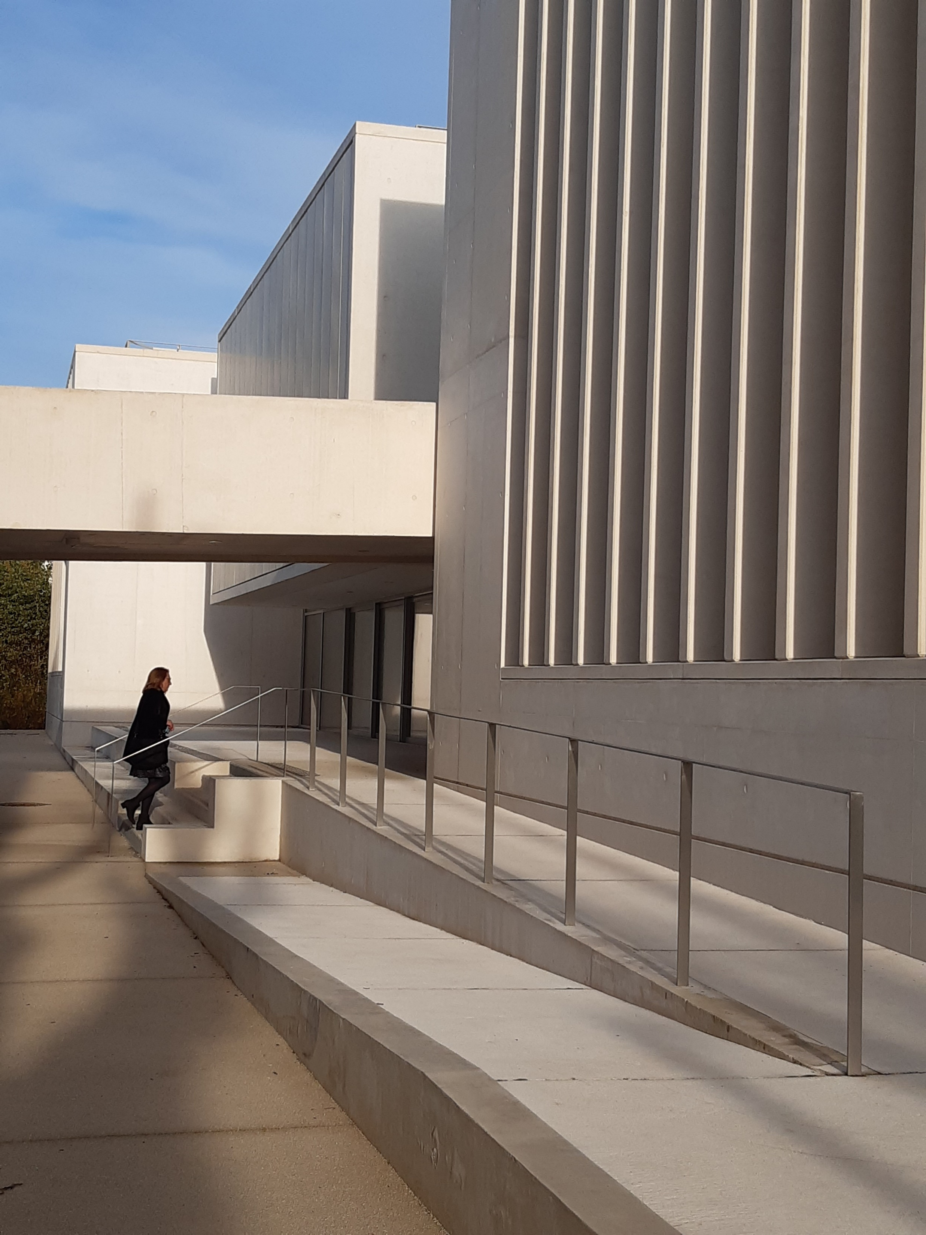
Practical solution for Campus Mobility, Inclusion and Laboratories: CAMPUS MAP MOBILE APPLICATION: “ To-get-there”
Improving mobility, and promoting inclusion by tracing the most suitable and effective itineraries
Features :
Maps of: City + Campus + inside buildings
audio guide for blind people + screen reading implementation
barrier-free pathways for people in wheelchair or old people
adapted facilities ; laboratories have mobile lab lift
available in different languages
Benefits :
Get to specific target
Special facilities mapped
empowerment gained for all users
high replicability for other universities
Accessibility should be the standard and not the exception.
Photo © A. Kostama-Goerger
alibaba.com

Slide 5
HOW TO SCALE UP?
Implicate students, staff, experts in Think tanks
Map existing practices in each university
Modelize the best practices within CIVIS network
Establish a common chart for European Civic University
Create a service-learning model to perpetuate action

Slide 6
TOGETHER,
unifying our abilities,
WE win !

