Slide 1
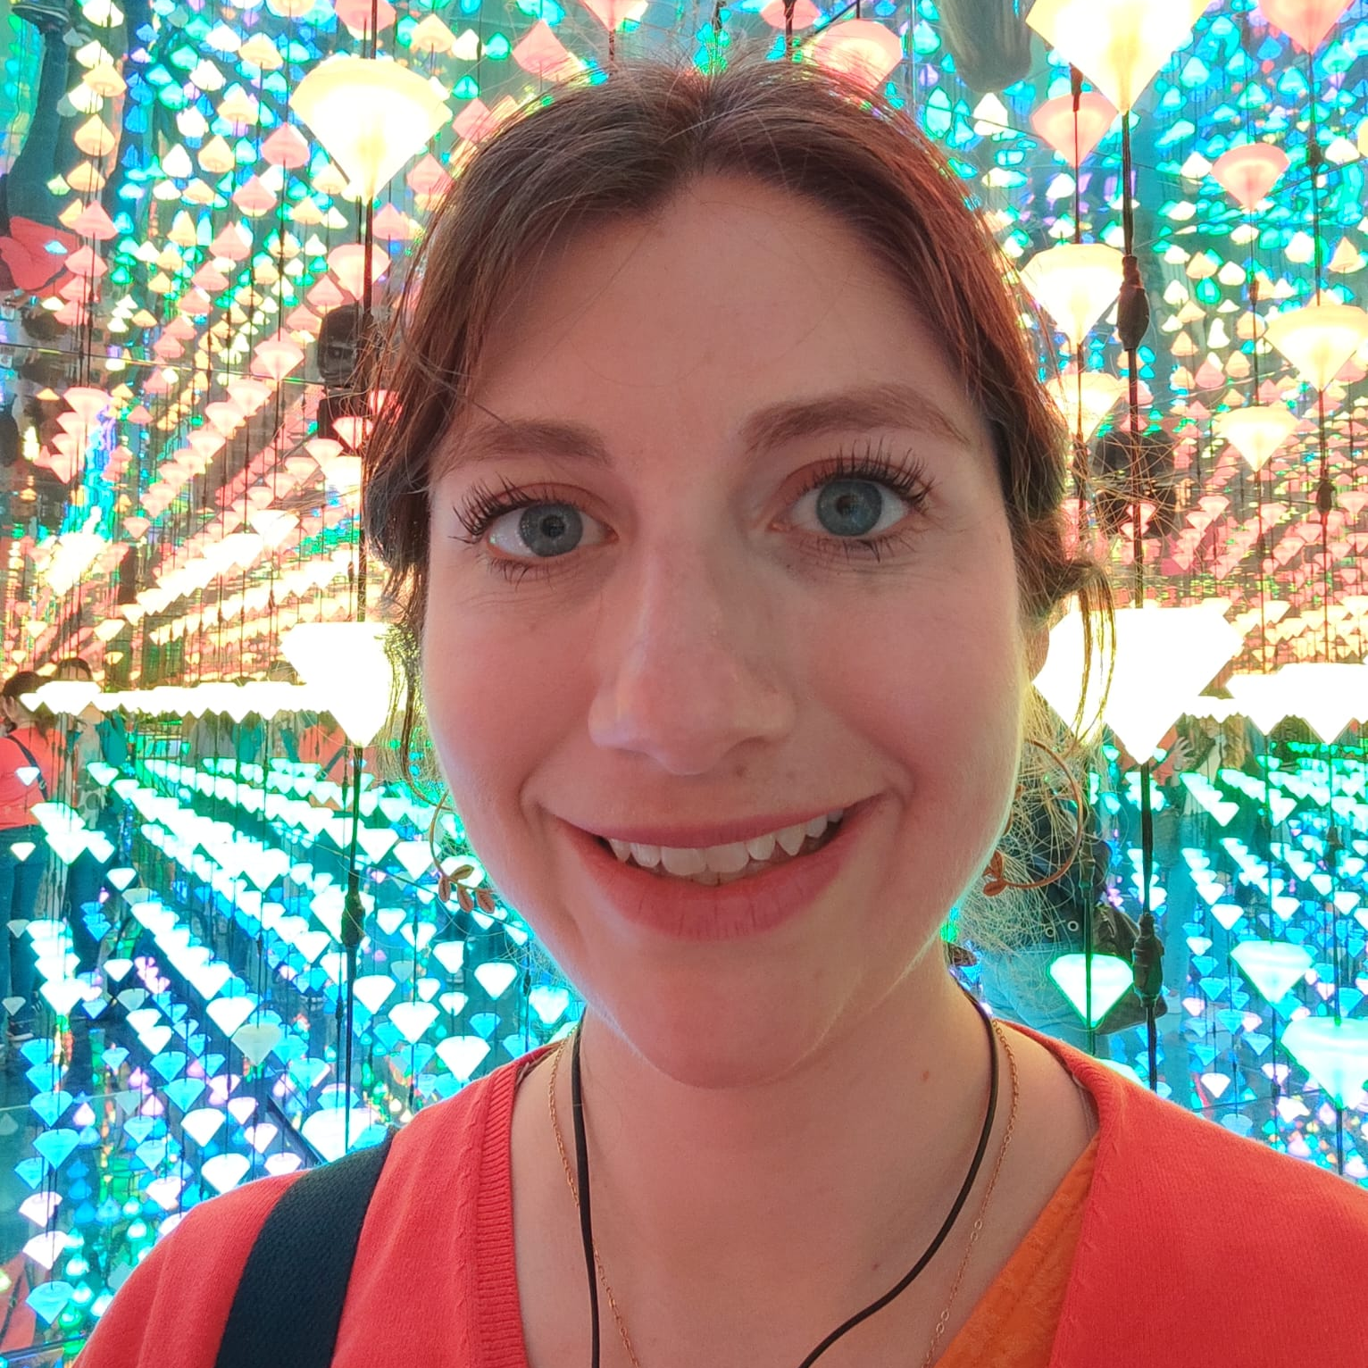


MGELS and the journey of writing a MSCA proposal
Susana Marín Aguilar
MSCA Postdoctoral Fellow
Sapienza University of Rome
June 2024
Notes:
HORIZON-MSCA-2022-PF-01: European Fellowships

Slide 2
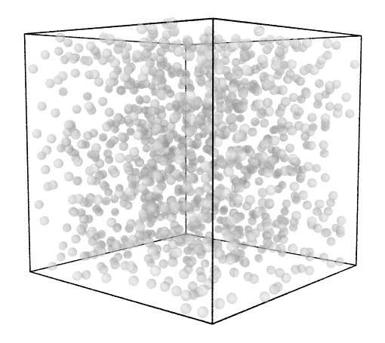

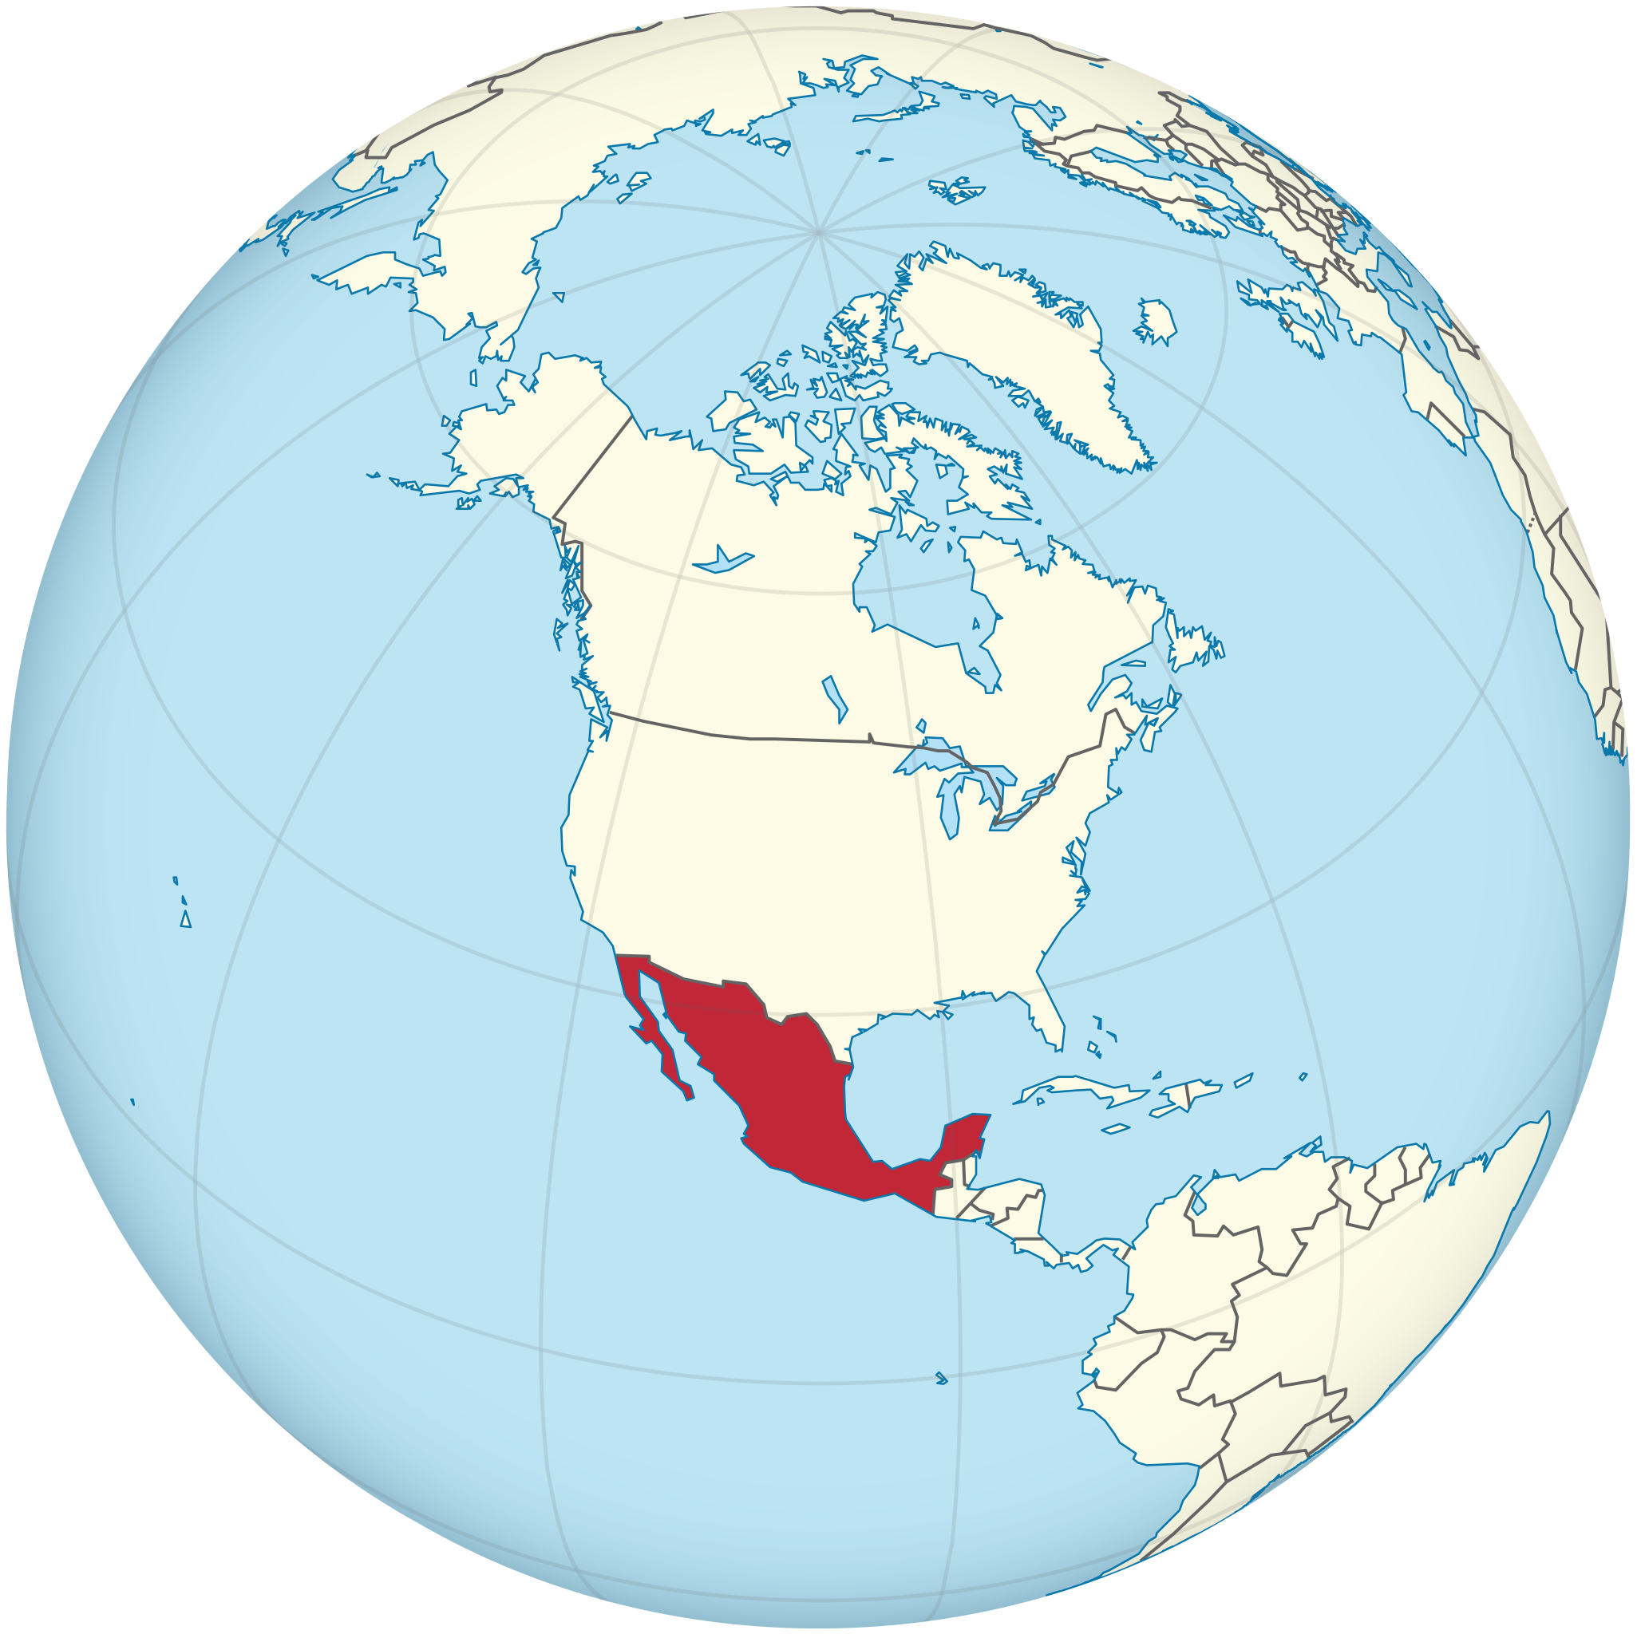
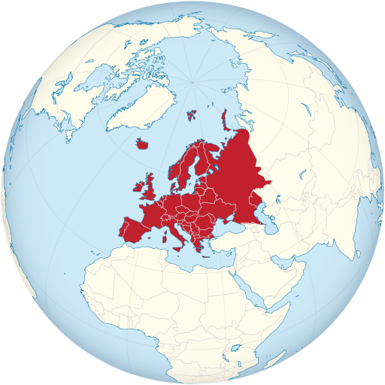
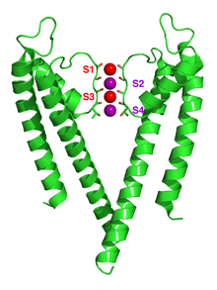

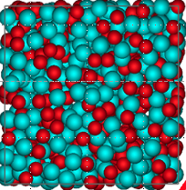




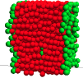
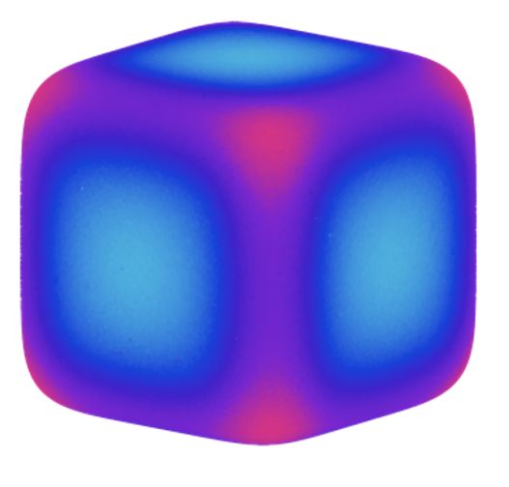
Career
BSc in Physics
Molecular Simulations
PhD in Physics
Postdoctoral researcher
MSCA
Mexico
UAEMex, Mexico
Université Paris-Saclay, France
Sapienza University, Italy
Ionic channels
Glassy colloids
2023
2017
Microgel particles
MSc in Physics
Postdoctoral researcher
2014
2020
Utrecht University, SCMB, Netherlands
Soft matter
UNAM, Mexico
Diblock copolymers
Self assembly
Gels
Colloids
Liquids
Polymers

Slide 3
Career
BSc in Physics
Molecular Simulations
PhD in Physics
Postdoctoral researcher
MSCA
Mexico
UAEMex, Mexico
Université Paris-Saclay, France
Sapienza University, Italy
Ionic channels
Glassy colloids
2017
2023
Microgel particles
MSc in Physics
Postdoctoral researcher
2014
2020
Utrecht University, SCMB, Netherlands
Soft matter
UNAM, Mexico
Diblock copolymers
Self assembly
Gels
Colloids
Liquids
Polymers

Slide 4
Career
BSc in Physics
Molecular Simulations
PhD in Physics
Postdoctoral researcher
MSCA
Mexico
UAEMex, Mexico
Université Paris-Saclay, France
Sapienza University of Rome, Italy
Ionic channels
Glassy colloids
2017
2024
Microgel particles
MSc in Physics
Postdoctoral researcher
2014
2020
Utrecht University, SCMB, Netherlands
Soft matter
Self assembly
Gels
Colloids
Liquids
Polymers
Machine Learning
Notes:
Develop more my career
Obtain experience on writing a funded project
To obtain new skills
To be more independent
To know a new group
To enlarge my CV

Slide 5


Writing the MSCA project (some of the important things IMO)
Time
Idea
Support
Place

Slide 6
Writing the MSCA project (some of the important things IMO)
Time
Idea
Support
Place

Slide 7
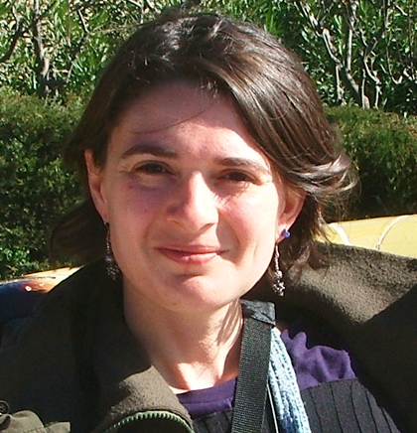
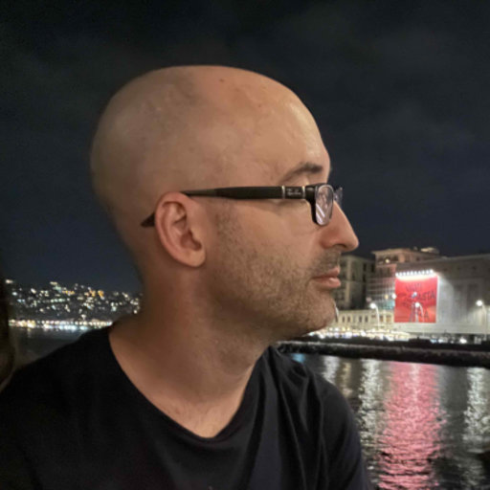

Writing the MSCA project (some of the important things IMO)
“MSCA Postdoctoral Fellowships enhance the creative and innovative potential of researchers holding a PhD and who wish to acquire new skills through advanced training, international, interdisciplinary and inter-sectoral mobility.”
Exchange of knowledge
Idea
😉
Key words are important
Machine Learning
Microgels
Time
New knowledge and skills
Support
Highlight it!
Place

Slide 8
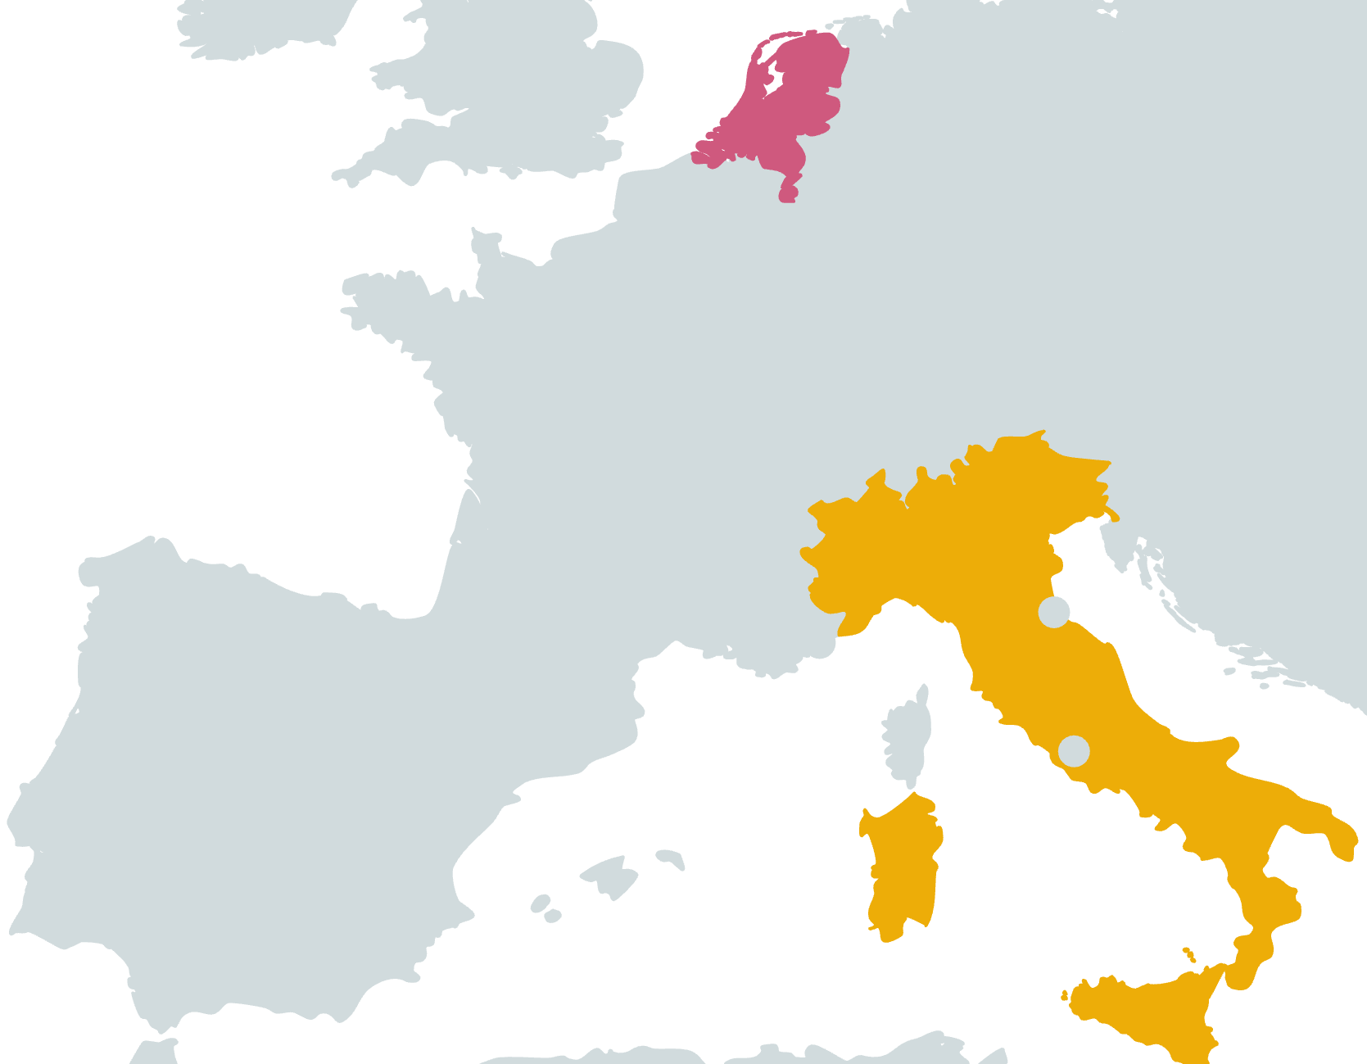

Writing the MSCA project (some of the important things IMO)
NL
“…MSCA Postdoctoral Fellowships aim to foster excellence through training and mobility…”
IT
Group/Principal Investigator:
How is the group? What are the skills you can learn and exchange? Can you collaborate within the group?
Place
University:
Infrastructure
Hard skills
Soft skills
Exchange of knowledge
Time
Idea
Advantages
of MSCA
Independence to develop a project
Support
Future/CV
Country

Slide 9
Writing the MSCA project (some of the important things IMO)
Deadline 11 Sep 2024
Take your time to write
Follow and answer ALL the points of the call
Time
Exchange of knowledge
Idea
Support
Place
Notes:
Details

Slide 10

Writing the MSCA project (some of the important things IMO)
Deadline 11 Sep 2024
Research office
Workshops
Support
Take your time to write
Follow and answer ALL the points of the call
Share the draft with your peers, with the PI, with the research office
Time
Enjoy the process!
Exchange of knowledge
Idea
Place
Notes:
Details

Slide 11
Writing the MSCA project (some of the important things IMO)
Summary
Highlight the skill/knowledge exchange
Be direct and concise
Answer all the points clearly
Use key words
Get support
Take your time to write
Do something you enjoy 😊
Time
Idea
Support
Place

Slide 12
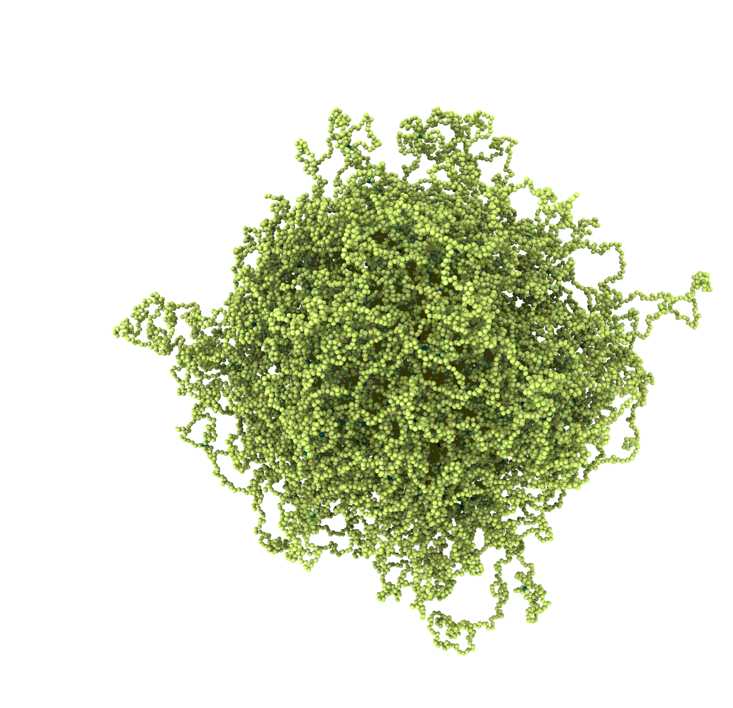
MGELS: the project
Machine-learning polymer Gel’s ELasticity and Structure
Structural properties
Elastic properties
Microgel
input
hidden layers
output
output

Slide 13
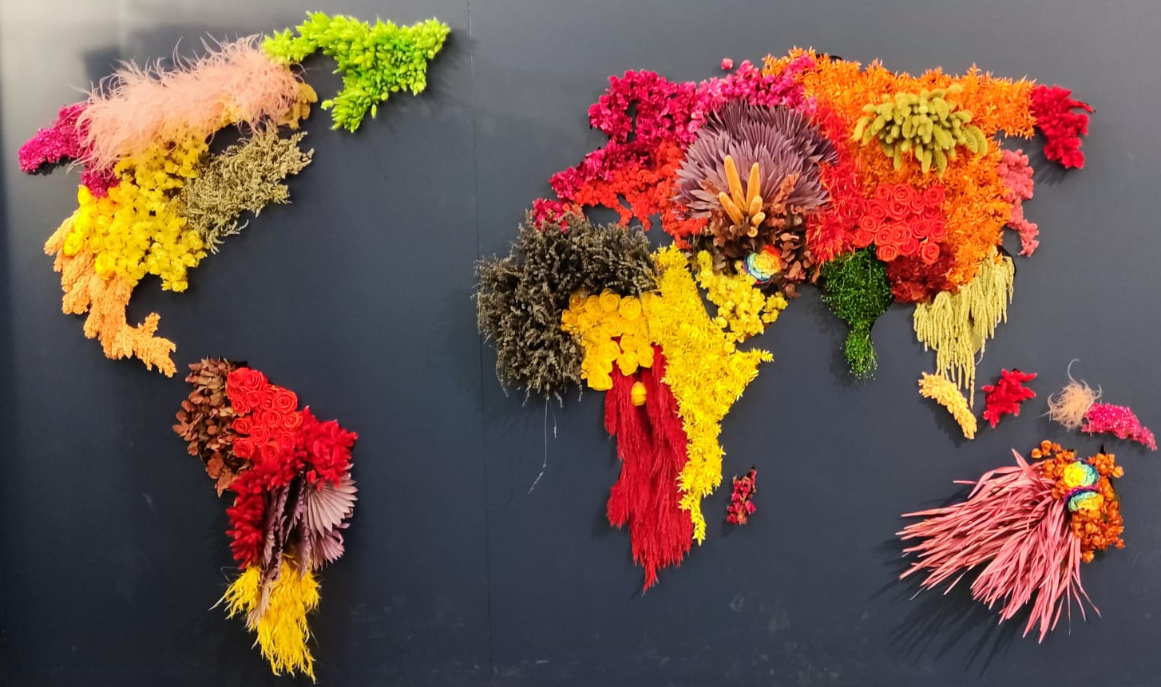
Thank you!
susana.marinaguilar@uniroma1.it

Slide 14
Writing the MSCA project (some of the important things IMO)
Deadline 11 Sep 2024
Take your time to write
Enjoy the process!
Follow and answer ALL the points of the call
Time
Share the draft with your peers, with the PI, with the research office
Research office
Workshops
Exchange of knowledge
Support
Idea
Place
Notes:
Details

Slide 15
Writing the MSCA project (some of the important things IMO)
Support
Exchange of knowledge
Time
Idea
Place

Slide 16
Writing the MSCA project (some of the important things IMO)
Time
Exchange of knowledge
Time
Idea
Support
Place

Slide 17
Career
BSc in Physics
PhD in Physics
Postdoctoral researcher
MSCA
Mexico
UAEMex, Mexico
Université Paris-Saclay, France
Sapienza University, Italy
Ionic channels
Glassy colloids
2017
2023
Microgel particles
MSc in Physics
Postdoctoral researcher
2014
UNAM, Mexico
2020
Utrecht University, SCMB, Netherlands
Diblock copolymers
Self assembly

