Slide 1
Synapses #5

Slide 2
Mobility - in the city
How to get to the different campus?
Distance between campus of the university
Hybrid system
(online+live)
Synapses
Education – Courses
Campus life - Sports
Information transfer between universities
Seminar online
Courses online
Social life in the university
Different sports
Cultural activities

Slide 3
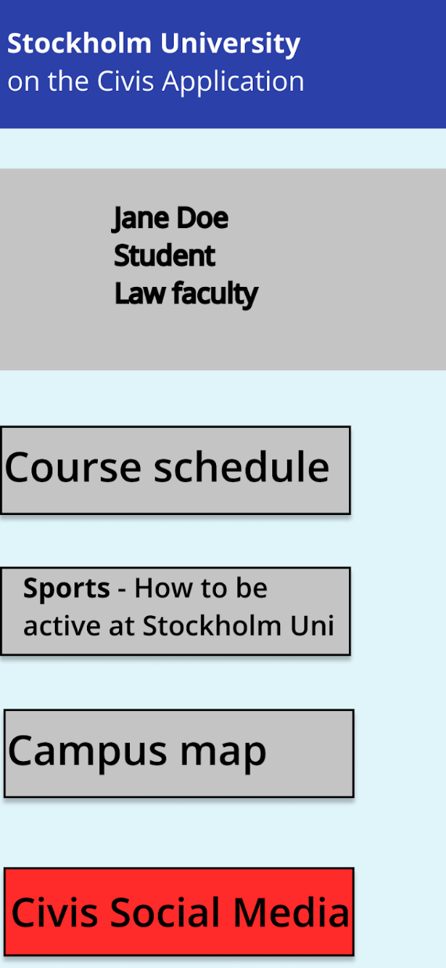
CIVIS APPLICATION
Starting Point for Students and Staff

Slide 4
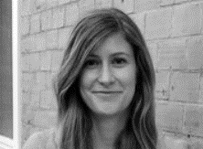
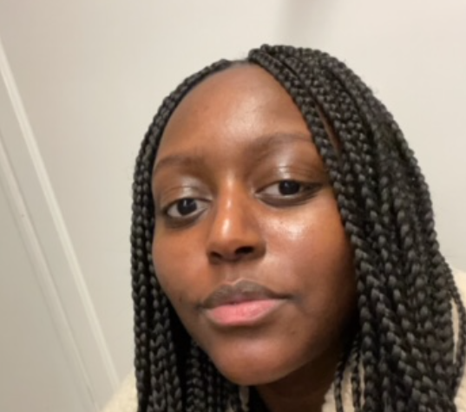
CIVIS Social Media Platform
Streamlining CIVIS internal information flows
What are you interested in?
(fields of research, hobbies …)
_ _ _ _ _ _ _ _ _ _
What are you interested in?
(fields of research, hobbies …)
_ _ _ _ _ _ _ _ _ _
What are you interested in?
(fields of research, hobbies …)
_ _ _ _ _ _ _ _ _ _
What are you interested in?
(fields of research, hobbies …)
_ _ _ _ _ _ _ _ _ _
Social Psychology
Social Psychology
Running
Running
@Social Cognition Lab in Athens
subscribe
@runners club in Madrid
subscribe
@kathrinreichman
PhD student studying social cognition
@britneykintu
Sports sciences student sharing running schedules
subscribe
subscribe
Social Psychology lecture – University of Tuebingen
more information
Course on „nutrition for runners“, University of Glasgow
more information

Slide 5
CIVIS Social Media Platform
Streamlining CIVIS internal information flows
Newsfeed of @janedoe
@Social Cognition Lab in Athens
Looking for a intern for 6 months for the upcoming summer! More information here.
@Runners Club in Madrid
Going for a run at 18:00 tomorrow (16.11.2021), about 10 km. Join in! We are meeting plaza mayor.
@CIVIS General
Looking for participants of our next Creathon (2022). Go here to sign up!

Slide 6
Synapses #5

