Slide 1
Marie Skłodowska-Curie Actions 2024
Postdoctoral Fellowships Characteristics

Slide 2
MSCA Postdoctoral Fellowships
MSCA-PF is the main instrument at Union-level to promote researchers’ career
Main Objectives & Characteristics:
Foster excellence through implementation of research project
Enhance the creative and innovative potential of researchers holding a PhD (training on transferable skills & career development)
Encourage 3i mobility (international, inter-sectoral, interdisciplinary)
Bridges and exposure to the non-academic sector
Research areas:
All scientific fields, including Euratom areas within existing scientific panels

Slide 3
MSCA Postdoctoral Fellowships
Expected outcomes for researchers:
Increased set of research and transferable skills and competences
New mind-sets and approaches to R&I work forged through 3i experience
Enhanced networking and communication capacities with peers, as well as with the general public
Expected outcomes for organisations:
Increased global attractiveness, visibility and reputation
Enhanced quality and sustainability of research training and supervision
Stronger R&I capacity and output; better transfer of knowledge

Slide 4
MSCA Postdoctoral Fellowships
Types of actions:
Mono-beneficiary action to support postdoctoral research and careers with:
European Postdoctoral Fellowships: R&I projects carried out entirely in Europe with a host institution located a EU Member State (MS) or Horizon Europe Associated Country (AC)*
Global Postdoctoral Fellowships: R&I projects carried out outside Europe with a mandatory return phase in Europe (1-2 years outside Europe + 1 year return in Europe)
NB: applications are made jointly by the researcher and a supervisor
*HE Associated Countries: Albania, Armenia, Bosnia and Herzegovina, Georgia, Faroe Islands, Iceland, Israel, Kosovo, Moldova, Montenegro, Morocco, North Macedonia, Norway, Serbia, Tunisia, Turkey, Ukraine, United Kingdom

Slide 5
MSCA Postdoctoral Fellowships
Participating Organisations* :
Legal entity in an EU Member State or HE Associated country
Recruited Researchers:
any nationality (Global Fellowships: nationals or long-term residents of MS/AC) *
in possession of PhD at the call deadline
up to 8 years research experience after PhD (with exceptions= career breaks, work outside research, research outside Europe for reintegrating researchers) –
mobility rule: not resided /main activity in the country of the beneficiary (or host organization for GF) more than 12 in the 36 months before call deadline
*Specific eligibility criteria for PFs supported by Euratom:
Organisation: legal entity established in an EU Member State or Euratom AC
Researcher: nationals or long-term residents of an EU Member State or a Euratom AC

Slide 6
MSCA Postdoctoral Fellowships
Duration
European Fellowships: 12-24 months
Global Fellowships: 24-36 months (12-24 outgoing phase + 12 months mandatory return phase in Europe)
Secondments
worldwide up to 1/3 of the fellowship duration
Placement
up to 6 months in a non-academic European organization at the end of the fellowship
Calls
2024: 23 April – 11 Sept; (overall budget 417 M€ approximately)
Resubmission restrictions for applications receiving a score below 70%

Slide 7
MSCA Postdoctoral Fellowships
Recruitment
Recruitment under an employment contract (or other direct contract with equivalent benefits) or, if not possible under national law, under fixed-amount fellowship agreement with minimum social security
Full-time employment unless part-time agreed by the Agency
Working exclusively for the action.
Researcher costs fully incurred for the benefit of the researcher

Slide 8
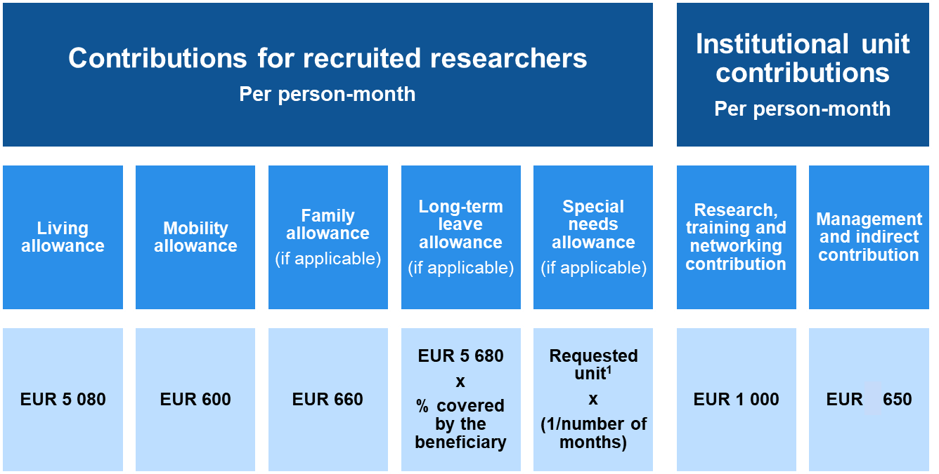
MSCA Postdoctoral Fellowships
EUR 5990
EUR 710

Slide 9
MSCA Postdoctoral Fellowships
Excellence | Impact | Quality and efficiency of the implementation
Quality and pertinence of the project’s research and innovation objectives (and the extent to which they are ambitious, and go beyond the state of the art) | Credibility of the measures to enhance the career perspectives and employability of the researcher and contribution to his/her skills development | Quality and effectiveness of the work plan, assessment of risks and appropriateness of the effort assigned to work packages
Soundness of the proposed methodology (including interdisciplinary approaches, consideration of the gender dimension and other diversity aspects if relevant for the research project, and the quality of open science practices) | Suitability and quality of the measures to maximise expected outcomes and impacts, as set out in the dissemination and exploitation plan, including communication activities | Quality and capacity of the host institutions and participating organisations, including hosting arrangements
Quality of the supervision, training and of the two-way transfer of knowledge between the researcher and the host | The magnitude and importance of the project’s contribution to the expected scientific, societal and economic impacts
Quality and appropriateness of the researcher’s professional experience, competences and skills
50% | 30% | 20%

Slide 10
MSCA Postdoctoral Fellowships Key elements of a successful proposal
SCIENTIFIC/SCHOLARLY EXCELLENCE
The research must be ambitious, original and innovative
It must fill existing scientific/scholarly gaps and contribute to advancements within the research field beyond the state-of-the-art
TRAINING & TRANSFER OF KNOWLEDGE
The proposal must include a well-defined training plan aimed at the acquisition of new knowledge and skills, both scientific and transversal
It should also describe the knowledge that will be transferred from the researcher to the host institution (two-way transfer of knowledge)

Slide 11
MSCA Postdoctoral Fellowships Key elements of a successful proposal
SUPERVISOR & HOST INSTITUTION
The choice of supervisor and host institution must be coherent with the research objectives and the skills to be acquired
It should be clear how the researcher will be integrated in the host institution
COMMUNICATION AND DISSEMINATION
The proposal must include a clear plan for dissemination and communication aimed at maximizing the impact of the research
All publications resulting from the project must be published in Open Access

Slide 12
MSCA Postdoctoral Fellowships Key elements of a successful proposal
IMPACT
It should clearly emerge what is the impact of the fellowship on the researcher’s career and how the project will contribute to generate an impact at the scientific, economic and/or social level
FEASIBILITY
The proposal must include a clear workplan to demonstrate the feasibility of the action
It is important to identify specific situations that might jeopardise the implementation of the action and the contingency and mitigation measures that can be implemented to avoid or reduce risks

Slide 13
MSCA Postdoctoral Fellowships Useful links
MSCA Postdoctoral Fellowships 2024
https://rea.ec.europa.eu/funding-and-grants/horizon-europe-marie-sklodowska-curie-actions/horizon-europe-msca-how-apply_en#postdoctoral-fellowships--call-2024
National Contact Points
http://ec.europa.eu/research/participants/portal/desktop/en/support/national_contact_points.html
Marie-Skłodowska-Curie Actions
http://ec.europa.eu/research/mariecurieactions/
The Mobility Portal (EURAXESS)
http://ec.europa.eu/euraxess/

Slide 14
Thank you for your attention!

