Slide 1
CIVIS & Research
Leticia Martinez Garcia
Project Coordinator, Université libre de Bruxelles
MSCA-PF Infoday 19th June 2024

Slide 2
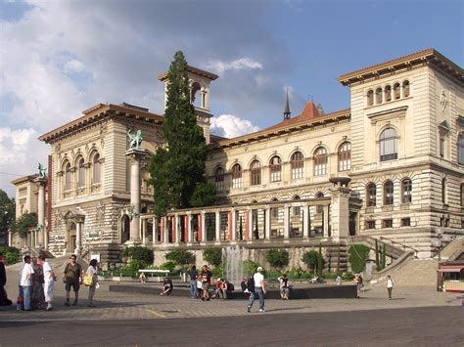
Content
CIVIS research objectives
CIVIS research structure
CIVIS platforms
MSCA-PF Supervisor’s data base
Further support

Slide 3
1. CIVIS research objectives
Promotion of collaborative inter-university research that can impact on complex societal challenges of the 21st century.
Strengthening interactions and co-creation of knowledge and skills between researchers, academics, citizens, businesses and the social and cultural sector.
Reinforcing the research links existing between the alliance partners through interdisciplinarity, shared research infrastructures and incentive funding for joint projects.
Stimulation of a collaborative culture and innovative ways of teaching fostering critical thinking, adaptability and forward-looking skills
Being a vector of change and innovation and a model for other University Alliances

Slide 4
2. CIVIS research structures
Educational programs linked to R&I
Research collaborations composed of researchers from CIVIS
Strong external partnerships focused on developing and funding research
HUBS
CIVIS CHALLENGES
Health
Climate, Environment and
Energy
Digital and Technological Transformation
Cities, Territories and mobilities
Society, Culture and Heritage
Educational, research and/or innovative projects
Projects addressing local and regional challenges
Shared platform for better collaboration among stakeholders
Citizen Science activities and local engagement
CALLS FOR PROPOSALS!!
(NEWSLETTER)
OPEN LABS
EXPERT GROUP HORIZON EUROPE
Members of all European Units of CIVIS Universities
Information on HEUR calls (TODAY )
Submission of projects (RIS4CIVIS + CIVIS3i)
Support networking between researchers
CIVIS RESEARCH COUNCIL
Vicerectors and Head of Research offices
Framework and strategy in R&I for the CIVIS Alliance
CIVIS helps you find a supervisor or a project partner!

Slide 5
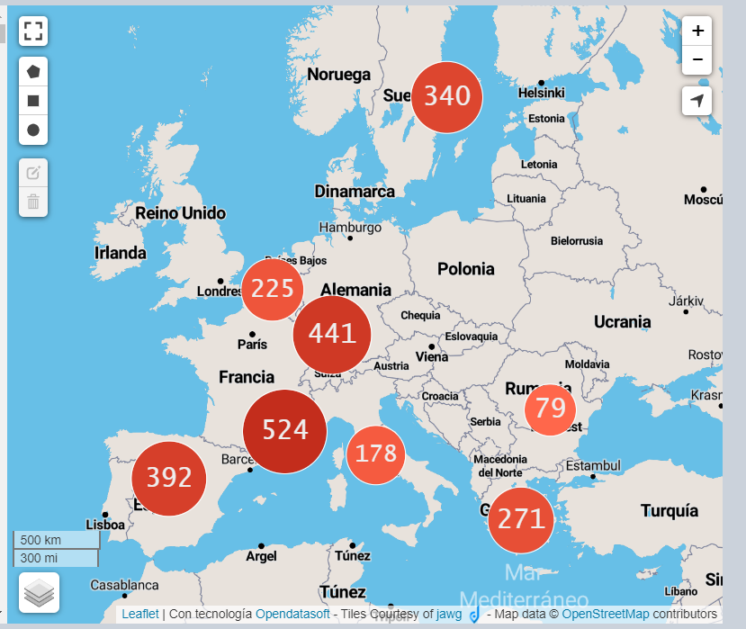
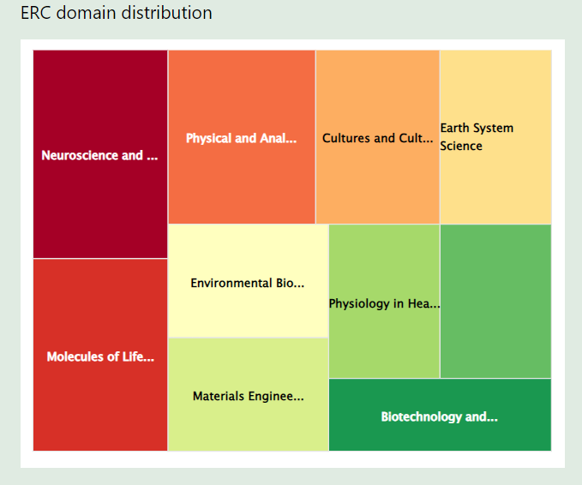
3. CIVIS platforms
Supervisor platform: Data base with 1800 professor profiles who are willing to welcome an MSCA-PF researcher
Research group platform: Here you can find all research groups from CIVIS universities classified by discipline
Infrastructure platform: This is a map of the different infrastructures at CIVIS level. You can find their service

Slide 6
4. MSCA – PF Support
The Marie Sklowdowska Curie Actions aim to equip researchers with the necessary skills and international experience for a successful career, either in the public or the private sector. The MSCA grants are open to all domains of research and innovation, from fundamental research to market take-up and innovation services. The MSCA actions have different calls: MSCA-PF, MSCA-DN, MSCA COFUND, etc
How can CIVIS help researchers with MSCA-PF?
Identification of potential supervisors at each CIVIS Institution based on research field
Procurement of a common “information & support” package for applicants
Applicants receive extensive support throughout the preparation and submission of proposal.
This includes:
One-to-one assistance during proposal preparation
Access to supporting materials
Participation to an online training and Q&A session

Slide 7
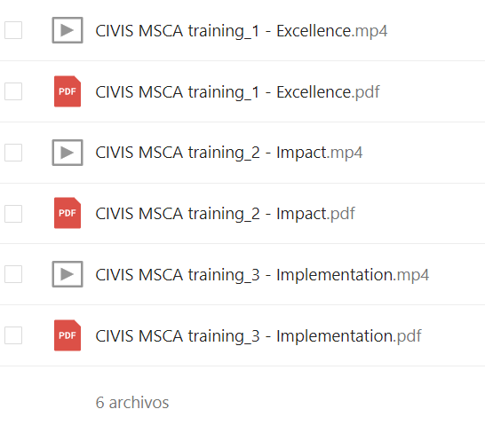
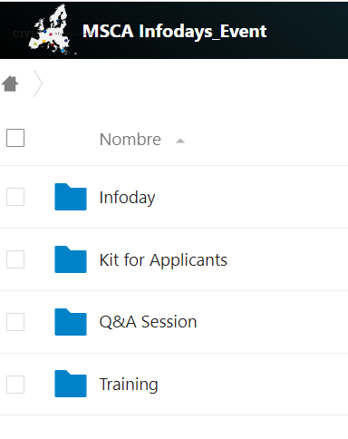
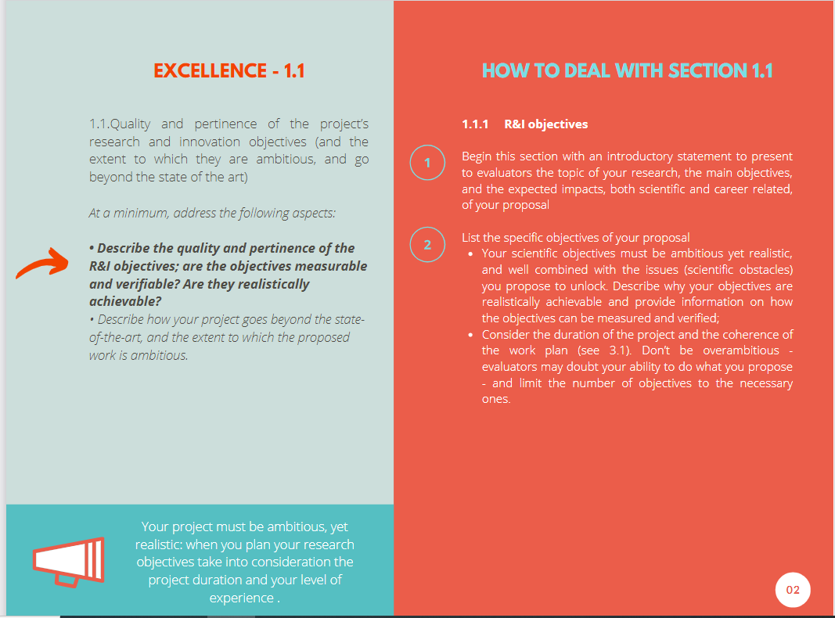
5. MSCA- PF support
Information only for applicants submitting an MSCA with any CIVIS university! Applicants can be from any other university!!
Proposal build up and submission (deadline: 11th September)
- CIVIS Training session (excellence, impact, implementation)
- Submission kit: how to submit and how to write the project
- Three Q&A sessions: July and August!

Slide 8
Contact Information
Aix-Marseille Université
Nicolas Gochgarian - drv-horizoneurope@univ-amu.fr
National & Kapodistrian University of Athens
Ilias Antoniou - ilantoniou@uoa.gr rc@elke.uoa.gr
University of Bucharest
Filuta Ionita - filuta.ionita@cdi.unibuc.ro
Université Libre de Bruxelles
Rachel Leproult, Dragana Petrovic, Sarah di Giglio, Giulia Sandri,
Amal Akheyar
ulb-europe@ulb.ac.be
Sapienza University of Rome
Rosa Di Stefano - rosadistefano@uniroma1.it
Stockholm University
Viviana Stechina- Viviana.stechina@su.se
Tübingen University
Christian Vöhringer - christian.voehringer@uni-tuebingen.de
University of Glasgow
Joe Galloway - rso-eufunding@glasgow.ac.uk
Universidad Autónoma de Madrid:
Rafael Oliveros - rafael.oliveros@uam.es
Rafaella Lenoir - rafaella.lenoir@uam.es

Slide 9
Thank you!
Questions?

