Slide 1
2
Sense of Belonging in the Context of New HE Alliances

Slide 2
5 Partners
2

Slide 3
Factors perceived as contributing to sense of belonging in eBelong 1
Common vision/goals
Personal values, commitment, dedication, vocation, human quality, expectation compatibility
Colleagues, networks, membership, inclusion, participation, team activities, social activities, joint projects, common research interests, centres, events.
Research and teaching support (training opportunities/career development)
Facilities
Environment/climate
Tradition, you representing the university, events, ceremonies
Request of opinions, dialogue, openness to innovation, appreciation, acknowledgement,
Trust, freedom, respect, participation to decisions, good relationship with management (management understanding the realities/needs), lack of corruption, meritocracy.

Slide 4
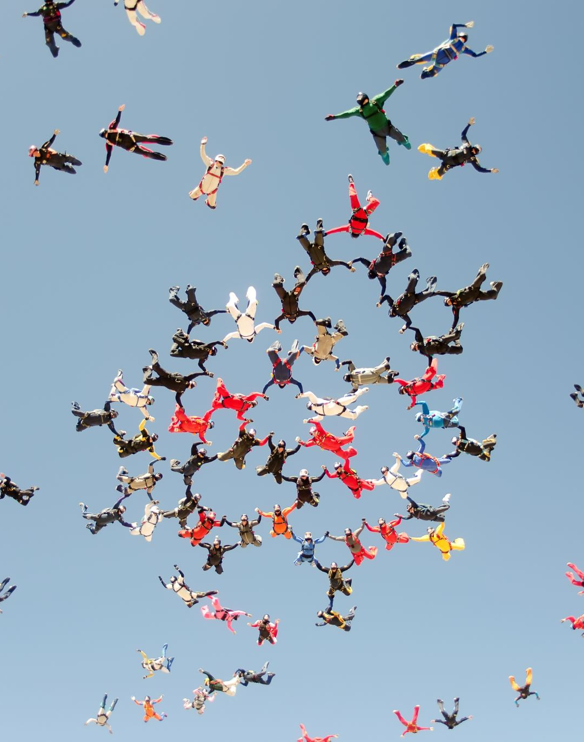
What would increase your sense of belonging?
Acknowledgement, especially of non-rated activities with students and management duties, appraisal, recognition.
Support (financial, career development)
Facilities (dedicated working spaces, health facilities)
Communities of practice – mentoring younger scholars, cooperation, collaboration, solidarity among colleagues, sharing teaching and research, learning communities.
Common activities outside work – teambuilding
Clear regulatory framework to support and protect – workload, administrative work, online working conditions, balance (btw personal and professional life, btw teaching and research duties)
More focus on wellbeing rather than costs
Counselling

Slide 5
Purpose of
2
comprehend the role of belonging within a partnership
explore the impact of a common culture based on cooperation and support, on inclusion, equity and diversity behaviours,
to sustain growth of learning communities within the alliance, both socially and emotionally, on long term.

Slide 6
Organizational culture
Shared set of values and beliefs
that can lead to norms
that guide the ways in which members approach their work,
interact with one another,
and solve problems
on an individual and team basis

Slide 7
Objectives of the project
Assessing the current operating culture of the partner universities in the alliance and the internal factors that are likely reinforcing the current culture.
Identifying levers for moving the partner universities’ current culture toward their alliance ideal, an inclusive culture, based on collaboration and support.
Developing a strategy for sustainable inclusion within the alliance.

Slide 8
3 Working packages
WP1. Assessing the current operating culture of the partner universities in the alliance and the internal factors that are likely reinforcing the current culture
- coordinated by UB
- timeframe 1.09.2023 – 30.08.2024
WP2. Identifying levers for moving the partner universities’ current culture toward their alliance ideal, an inclusive culture, based on collaboration and support
-coordinated by KNUA
- timeframe 1.09.2024 – 30.08.2025
WP3. Developing a strategy for sustainable inclusion within the alliance
-coordinated by AMU
- timeframe 1.09.2025 – 30.08.2026

Slide 9
WP1. Assessing the current operating culture of the partner universities in the alliance and the internal factors that are likely reinforcing the current culture
OBJECTIVES
1. Defining inclusive HE cultures in the context of the CIVIS alliance.
2. Analysing the current operating culture of the partner universities in the alliance and the internal factors that are likely reinforcing the current culture (and, in turn, can be used as levers for change).
3. Identifying levers for moving the partner universities’ current culture toward their alliance ideal, an inclusive culture, based on collaboration and support.

Slide 10
OCI, OEI, OCI Ideal – licenced instruments
OCI - Organizational Culture Inventory - transforming culture
OEI - Organizational Effectiveness Inventory - transforming climate
OCI Ideal - Organizational Culture Inventory – ideal culture

Slide 11
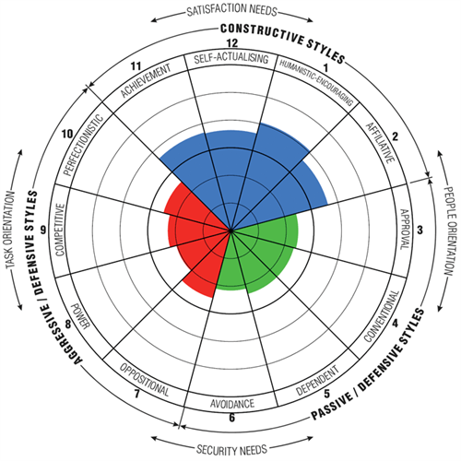
Three general types of behavioural styles
Constructive Cultures: Members are encouraged to interact with people and approach tasks in ways that will help them meet their higher order satisfaction needs (with norms encouraging Achievement, Self-Actualizing, Humanistic-Encouraging, and Affiliative behaviours).
﻿Passive/Defensive Cultures: Members believe they must interact with people in self-protective ways that will not threaten their own security (with norms requiring Approval, Conventional, Dependent and Avoidance behaviours).
Aggressive/Defensive Cultures: Members believe they are expected to approach tasks in forceful ways to maintain their status and security (with norms requiring Oppositional, Power, Competitive, and Perfectionistic behaviours).

Slide 12
Topics Benefits
1. How can we improve the quality of internationalization management?
2. What are innovative formats for joint staff development that go beyond ERASMUS Staff Weeks?
3. In which management areas can joint non-academic staff development initiatives underpin the overall CIVIS objectives? What could be concrete measures?
Engagement & Performance
Diversity & Inclusion
Teamwork & Collaboration
Beneficiaries Experience (students and academics)
Innovation & Adaptability
Mergers (CIVIS alliance)
Strategy Implementation

Slide 13
Advantages for CIVIS
Unify leadership around a clear mission, ideal culture, and vision for the future.
Establish a baseline measure for culture and a common language for culture change.
Complement organizational change efforts with leadership development.
Refine strategies and plans based on your improved understanding of culture.
Connect culture to results and organizational outcomes with a clear roadmap.

Slide 14
2
Sense of Belonging in the Context of New HE Alliances
https://ebelong.unibuc.ro/
THANK YOU!
camelia.radulescu@fpse.unibuc.ro
learningcenter@unibuc.ro

